Slide 1
CAPSTONE PROJECT
Netflix data analysis
Presented By:
R.Venkatesh
Sree Krishna College of Engineering
Mechanical Engineering

Slide 2
OUTLINE
Proposed System/Solution
System Development Approach
Algorithm & Deployment
Result
Conclusion
Future Scope
References

Slide 3
PROPOSED SYSTEM/SOLUTION
Implement mechanisms to collect diverse data sources including user interactions (watch history, ratings, searches), content metadata (genre, cast, crew), platform performance metrics (streaming quality, playback interruptions), and external factors (market trends, cultural events).
Conduct data preprocessing tasks such as data cleaning, normalization, and transformation to ensure data quality and consistency. This step may also involve feature engineering to extract relevant features from raw data that can be used for analysis and modeling.
Apply a variety of analytical techniques including machine learning, statistical analysis, and deep learning to derive insights from the collected data. This may involve building models for recommendation systems, predictive analytics, audience segmentation, content categorization, and sentiment analysis.

Slide 4
SYSTEM APPROACH
Building the proposed solution would involve a combination of data processing, feature engineering, and machine learning. Here are the key system and library requirements
System Requirements:
A computer with sufficient processing power, preferably with multiple cores or a GPU for faster training of machine learning models
Adequate RAM at least 4GB RAM to handle the size of the dataset and computational requirements.
2. Software:
An operating system compatible with the required machine learning libraries (e.g., Windows, Linux, mac OS).

Slide 5
ALGORITHM & DEPLOYMENT
Collaborative filtering : which analyzes user behavior and preferences to suggest content similar to what a user has already watched or liked. They also utilize content-based filtering, which recommends content based on attributes and features of the content itself, such as genre, actors, directors, and keywords. Additionally, Netflix employs machine learning algorithms for personalized recommendations, predictive analytics for content acquisition and production decisions, and deep learning algorithms for image and video analysis, among others.
Clustering algorithms for categorizing content into different genres, themes, or audience segments. These algorithms analyze various attributes of movies and TV shows, such as genre, plot, cast, and user engagement data, to group similar content together. By categorizing content effectively, Netflix can offer personalized recommendations and create curated collections that cater to different tastes and preferences. This approach enhances user satisfaction and helps users discover new content that aligns with their interests.

Slide 6
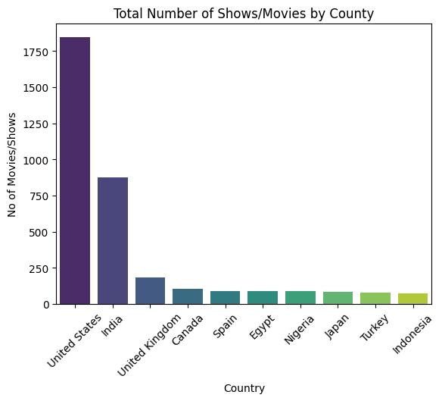
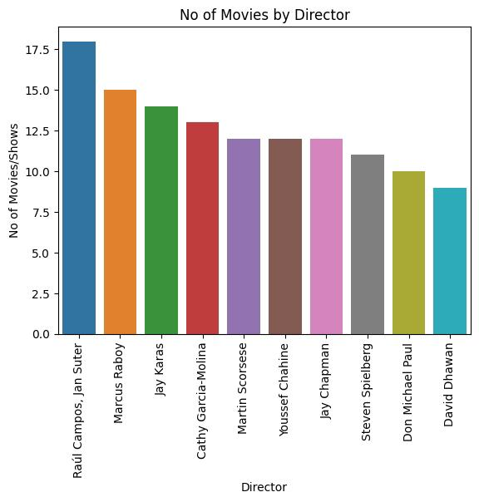
RESULT

Slide 7
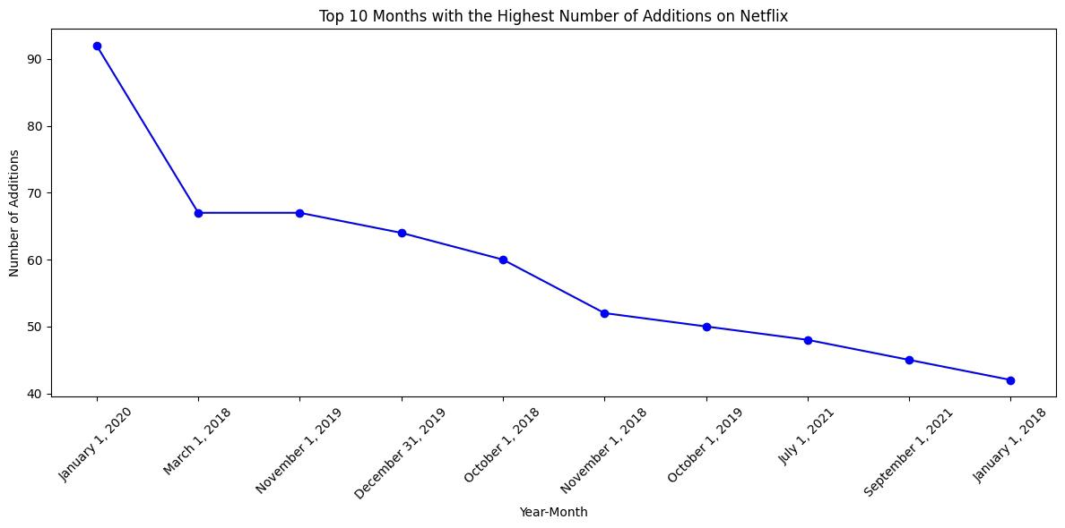
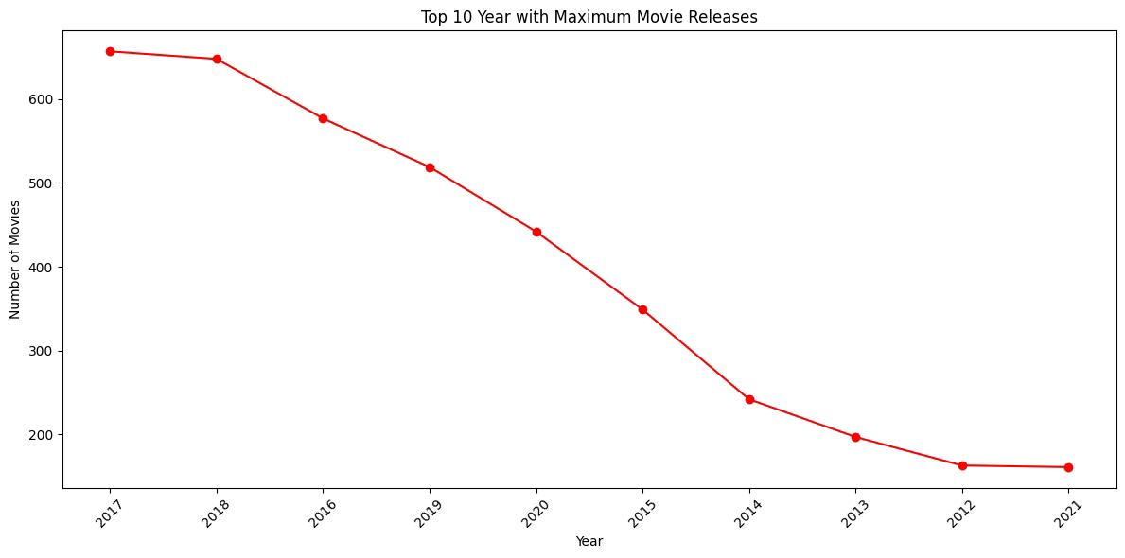
RESULT

Slide 8
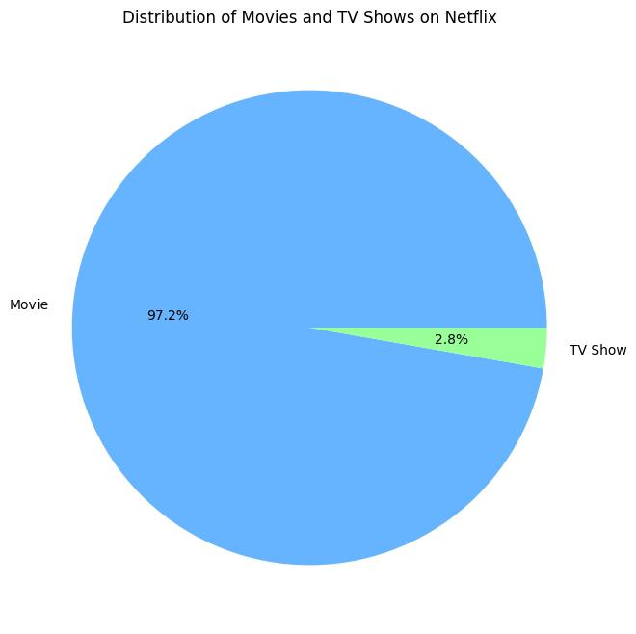
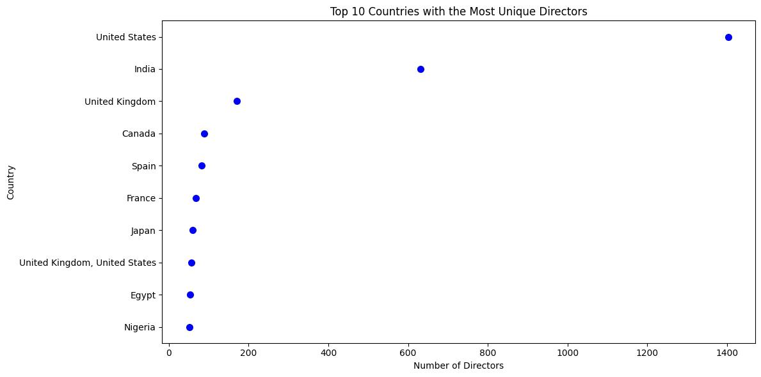
RESULT

Slide 9
CONCLUSION
In conclusion, a variety of sophisticated algorithms and data analysis techniques to enhance user experience, optimize content recommendations, and drive business decisions. These algorithms include collaborative filtering, content-based filtering, machine learning for personalized recommendations, predictive analytics for content acquisition, deep learning for image and video analysis, and clustering algorithms for categorizing content. By leveraging big data and advanced analytics, continuously refines its platform to deliver personalized, engaging, and relevant content to millions of subscribers worldwide, ultimately fostering customer satisfaction

Slide 10
FUTURE SCOPE
Enhanced Personalization: Further refinement of recommendation algorithms to provide even more personalized content suggestions based on individual viewing habits, preferences, and context. This could involve integrating additional data sources such as social media activity, location data, and biometric feedback for more granular personalization.
Content Creation and Acquisition: Utilizing data analysis to inform content creation and acquisition strategies, including predicting audience demand for specific genres, themes, and formats. This may involve leveraging sentiment analysis, trend forecasting, and audience segmentation to identify emerging trends and niche markets.

Slide 11
REFERENCES
https://www.kaggle.com/datasets/shivamb/netflix-shows
https://youtu.be/GsfT2sv_zCo?feature=shared

Slide 12
THANK YOU

